Slide 1

CMC Press
Your Guide to the Mountain West

Slide 2
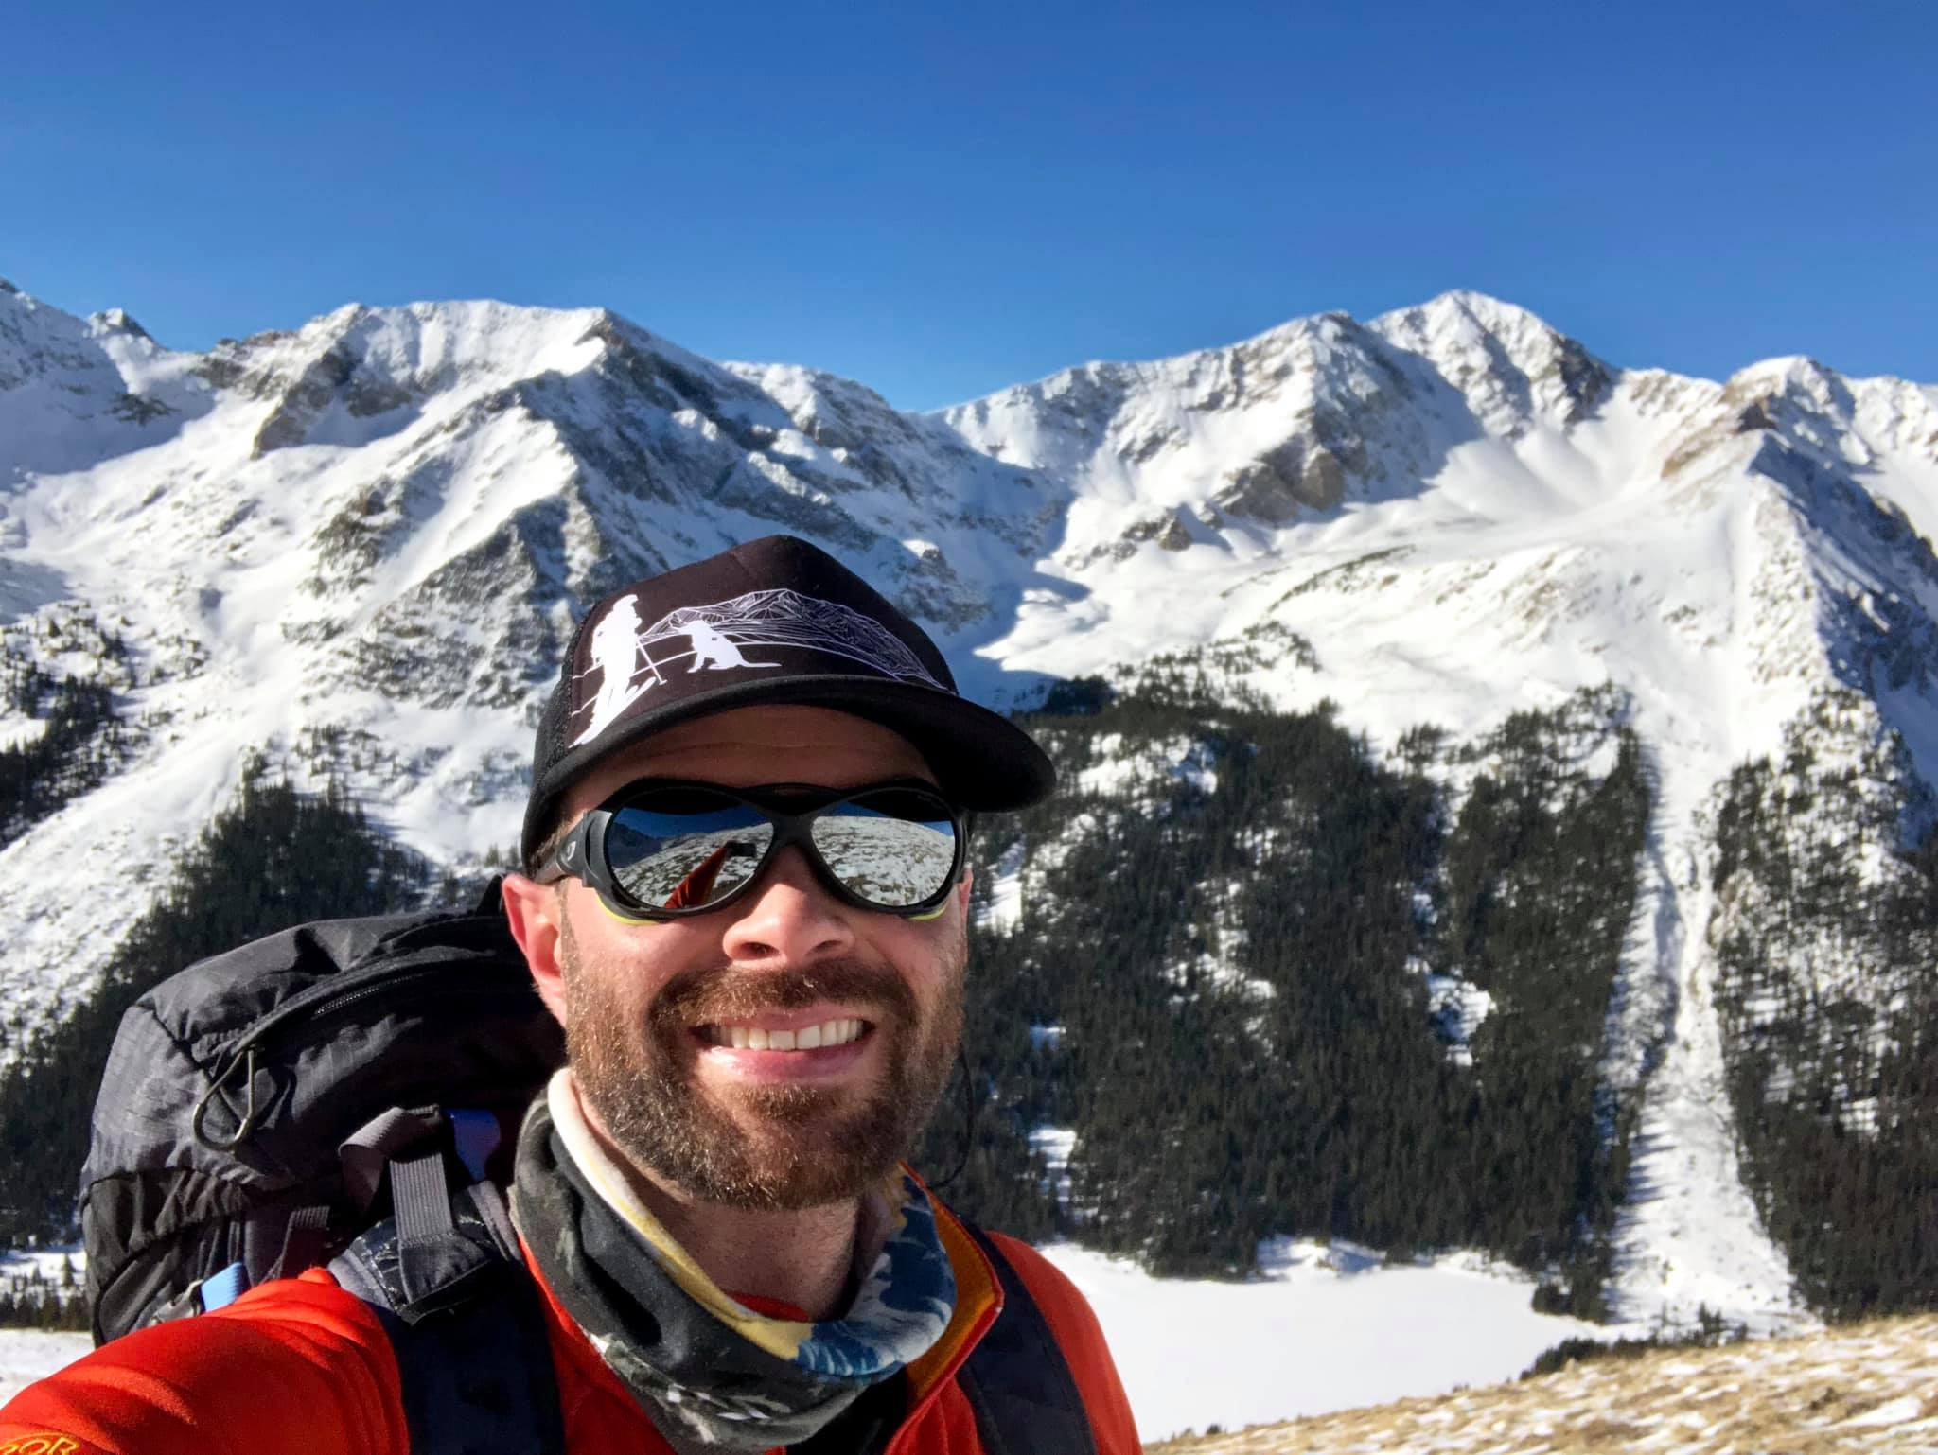
Who Am I?

Slide 3

What Do We Do?
CMC Press net revenue all goes back into the Club! Your dollars support CMC education and conservation programs.
65+ Guidebooks
All Mountain Activities
Covers Entire Mountain West
6-8 New Releases a Year
National Distribution via The Mountaineers Books

Slide 4
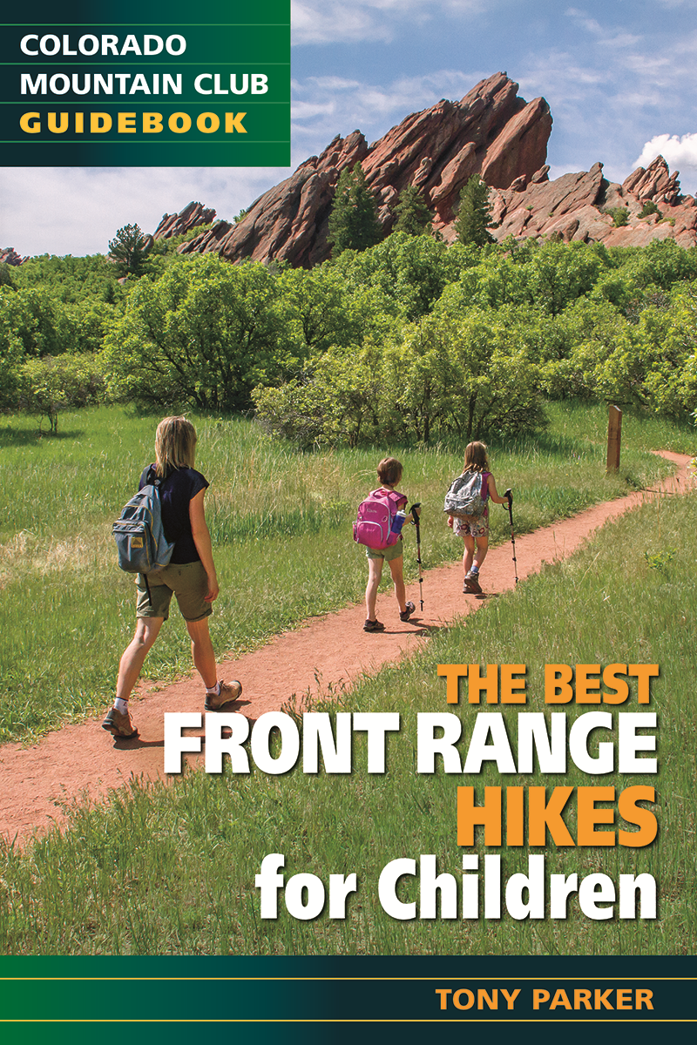
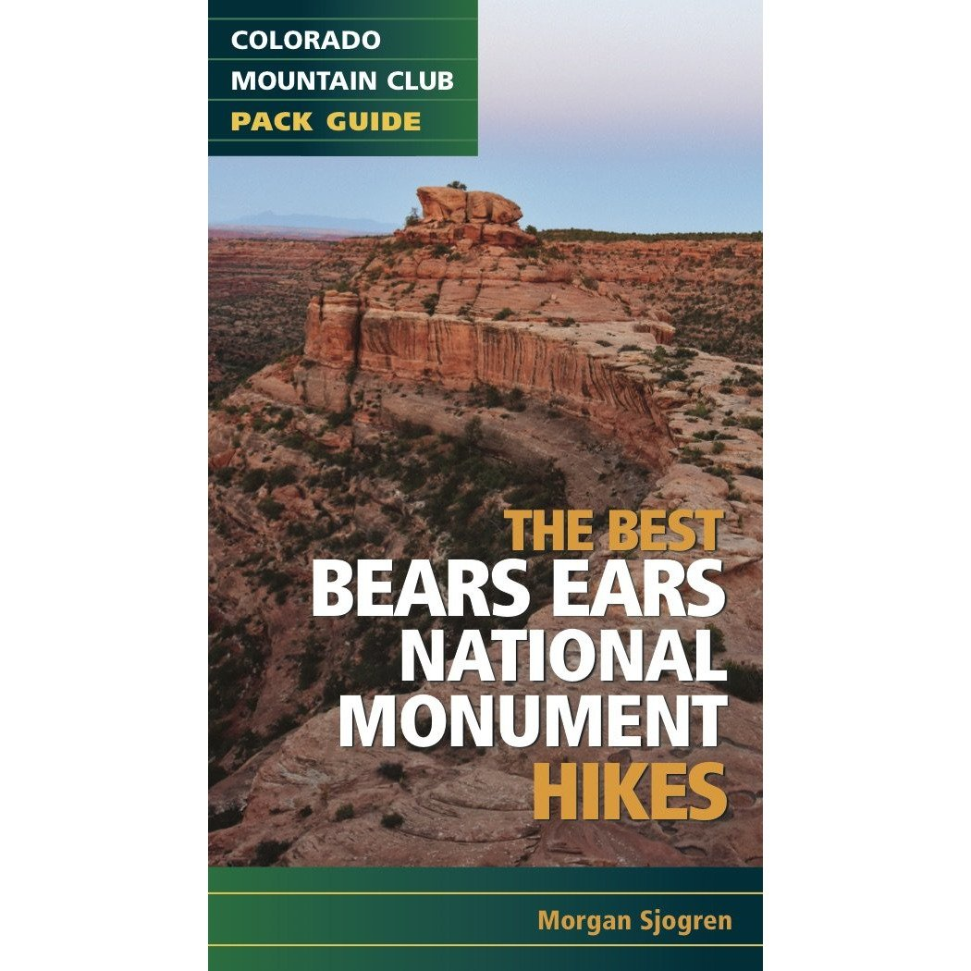
Full Size vs. Pack Guides
9in
7in
4in
6in

Slide 5
Who Writes the Guides?
The LOCAL experts! Our guidebooks are often written by CMC members, including sometimes entire schools or sections. We also work with freelance writers and other seasoned backcountry veterans.
Every author has personally completed every route in every book
Most writers have decades of experience in their favorite sports
GPX tracks, mapping software, and personal experience are cross-referenced to ensure accuracy

Slide 6
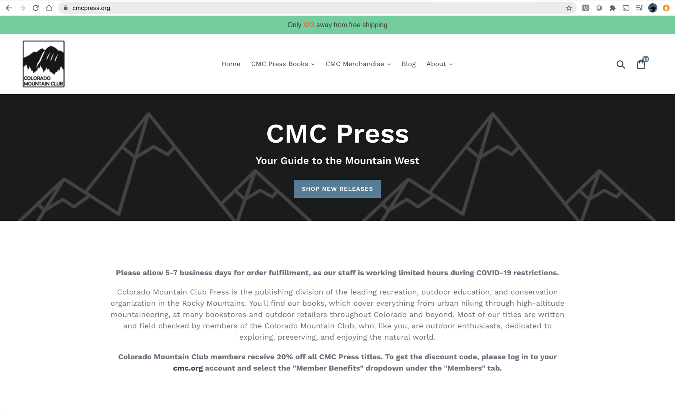
Where Can You Find Us?
cmcpress.org
CMC events and main office
Local bookstores and gear shops
REI
Amazon

Slide 7
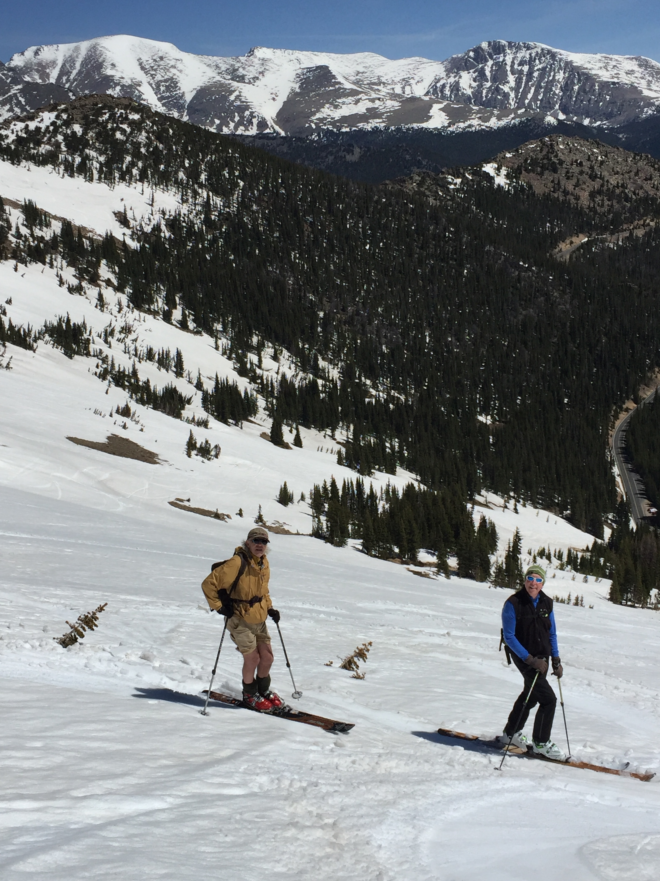
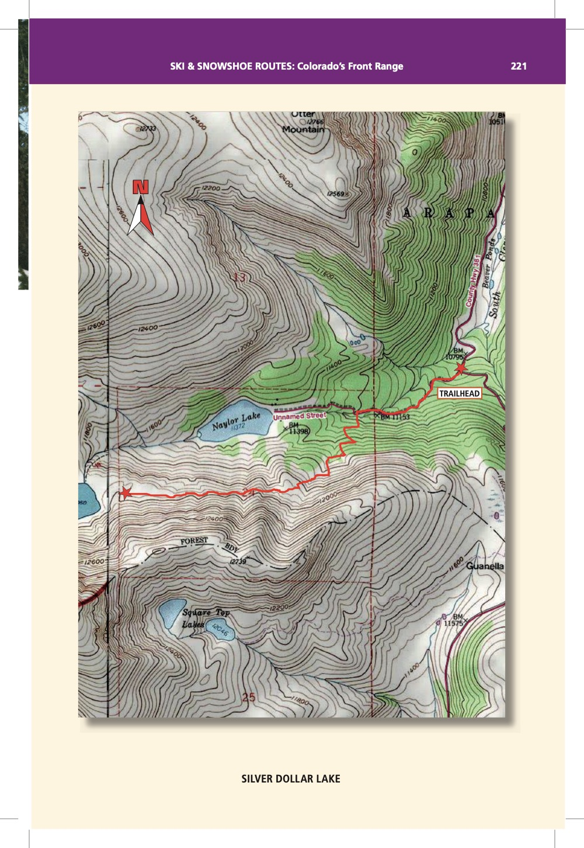
Using Our Guidebooks

Slide 8
Become an Author
To submit your pitch for consideration, please email all of the following to cmcpress@cmc.org:
Author Bio, Qualifications, and Work Samples
Book Pitch (What's it all about?)
Sample Table of Contents
Sample Chapter
Competitive Review (What comparable titles are already in print, and how is yours different?)

Slide 9
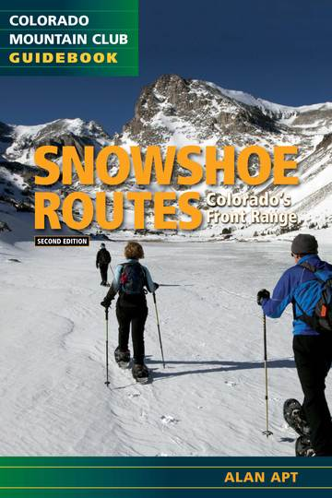
Best Sellers
The Colorado Trail, 9th Edition
The Colorado Trail Databook, 7th Edition
Rocky Mountain Wildflowers, 2nd Edition
The Colorado 14ers: The Best Routes
The Best Front Range Hikes
Snowshoe Routes: Colorado’s Front Range

Slide 10
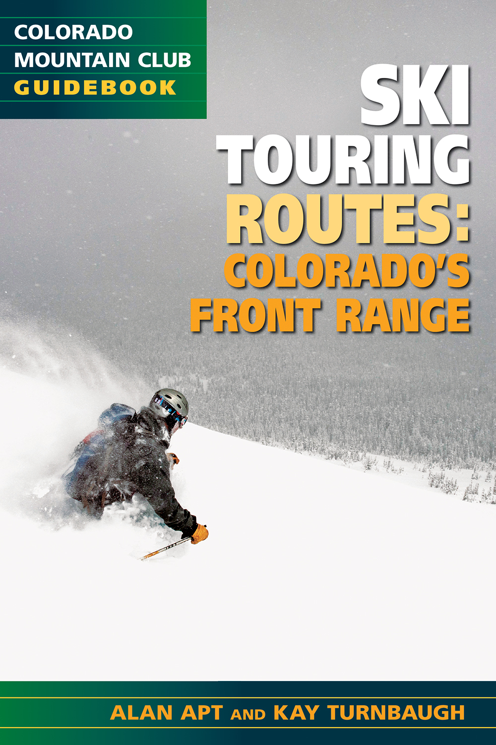
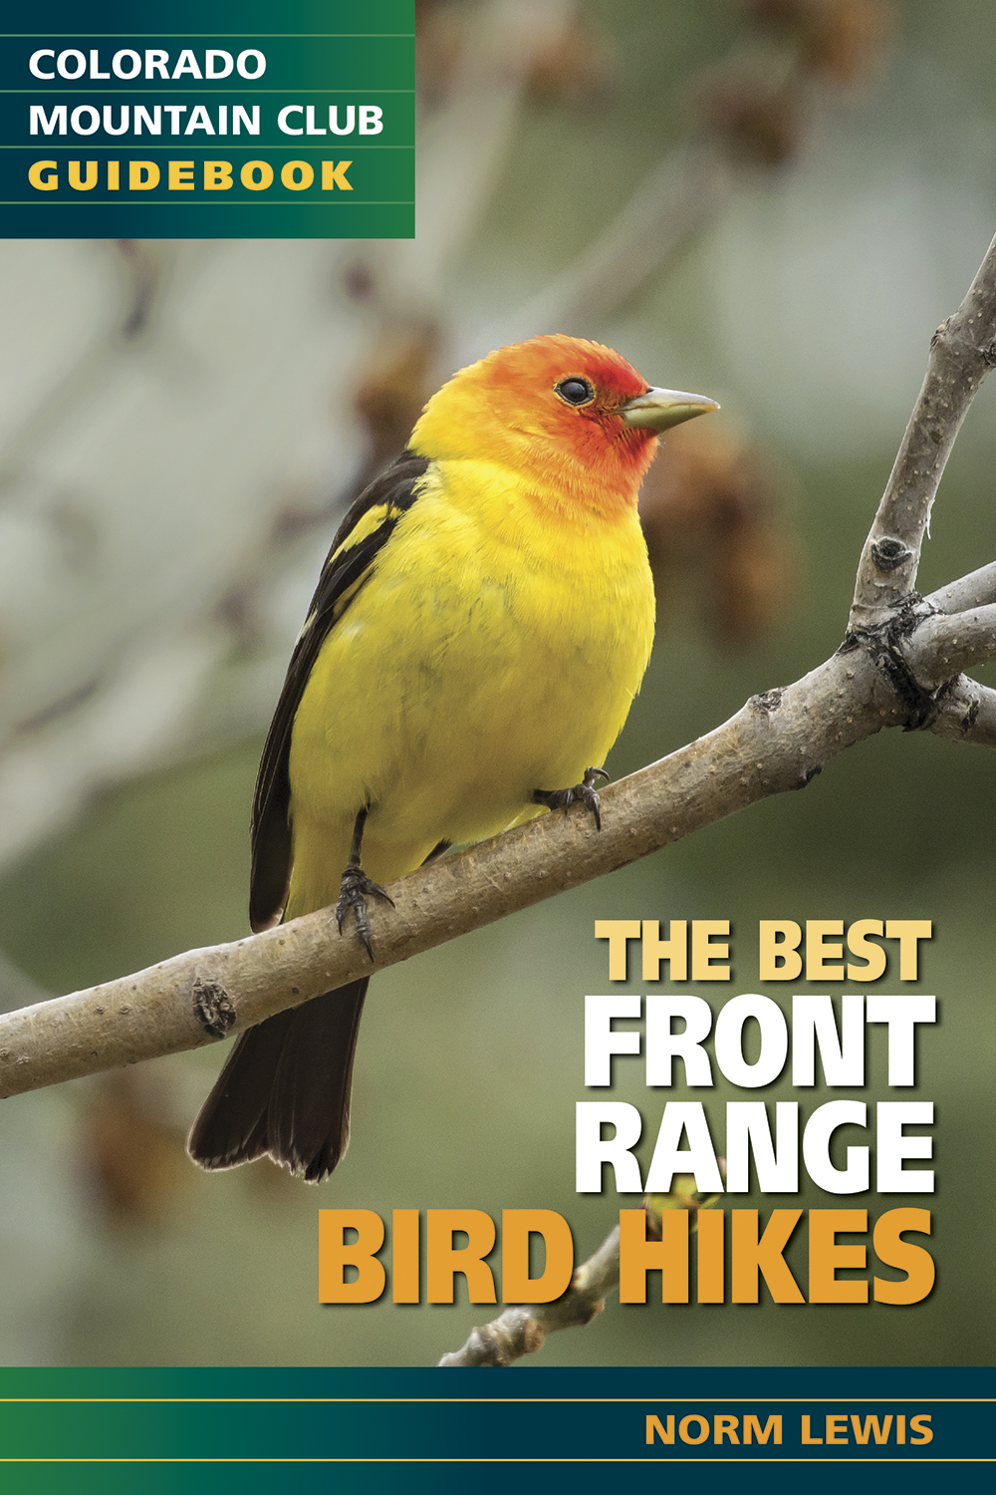
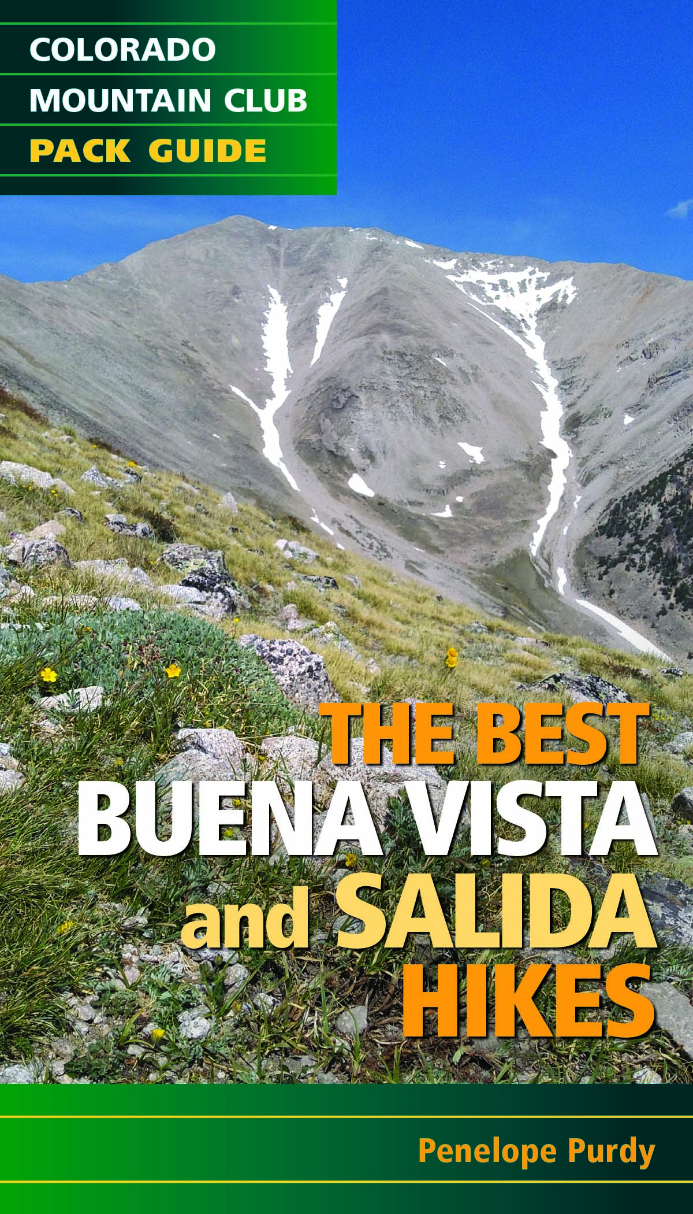
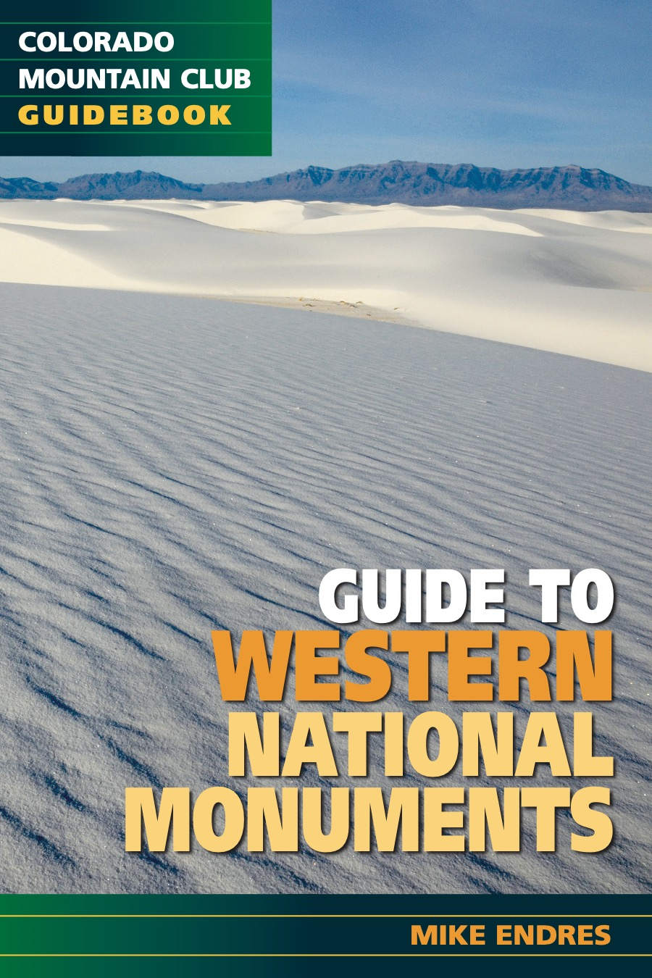
Sneak Preview!

Slide 11
Questions?
cmcpress.org

